Slide 1



C++ Boot Camp
Welcome to the final presentation of the course

Slide 2

AGENDA
1
Welcome
2
Course background
3
Team presentations
4
Final words
5
Open space

Slide 3
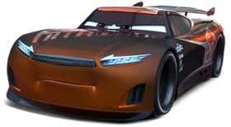
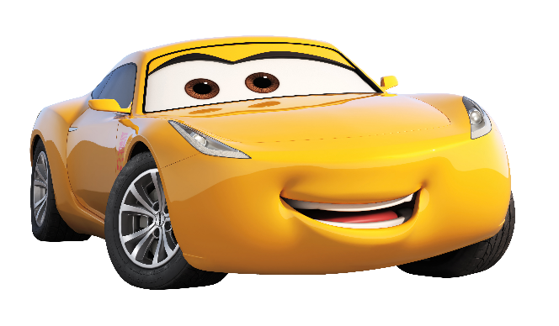
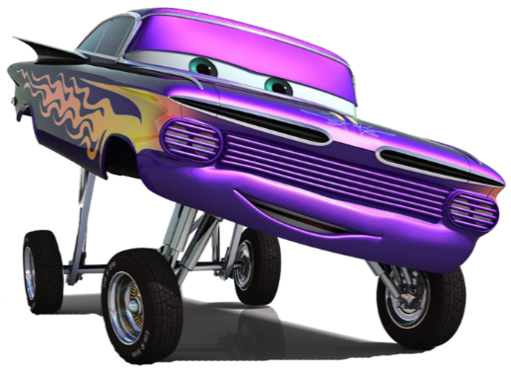

Team presentations
© M. Rashid Zamani
Team
Presentation

Slide 4
Team presentations
Team Treadless!

Slide 5
Treadless

Slide 6
Team Smokey!

Slide 7
Smokey

Slide 8
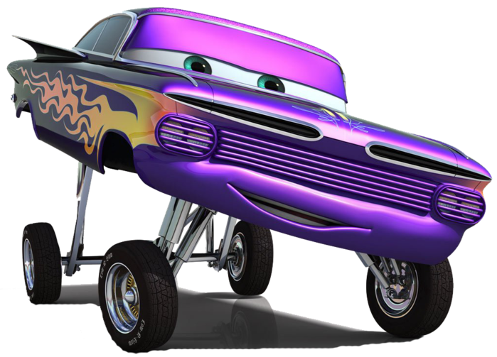
Team Ramone!

Slide 9
Ramone
Team Presentation
Noureldin Fouad
PER Ternström
Software Developer at Common Base Technology (CBT)
System Developer at Exterior Lighting
Stina Karnlind
Taycir louati
System Developer at Protective Safety
Software Developer at Active Safety Functions
Team Ramone

Slide 10
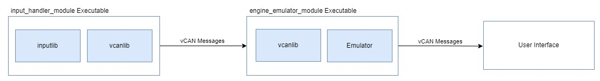
Ramone
System Overview

Slide 11
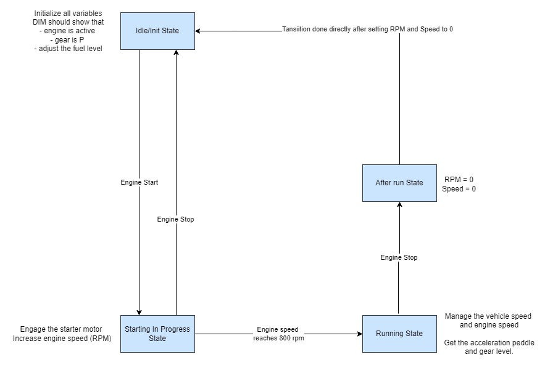
Ramone
State Machine

Slide 12
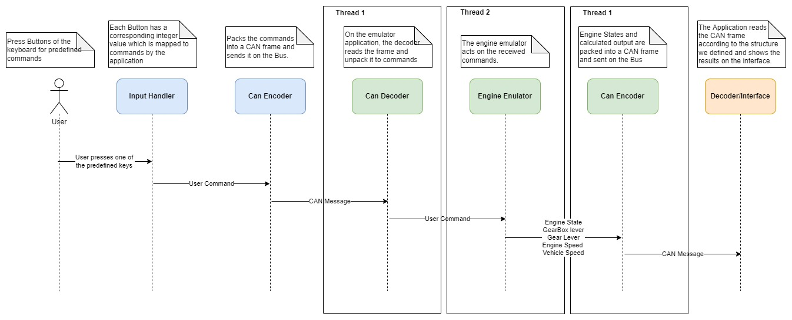
Ramone
Sequence Diagram

Slide 13
Ramone
Engine Simulator Demo

Slide 14
Ramone
Performing Team project
Challenges
Managing tools for code review (Git/Github) and resolving conflicts.
Technical challenges
Learnings
Concepts that have been learned during the lectures applied and practiced in the project.
Acquired knowledge about Engine and Gearbox systems.
Linux Operating System
Things being Proud of
We have been able to reach the objectives we planned for each sprint as a team.
Deliver an Engine Gearbox Simulator.

Slide 15
Ramone
BootCamp reflection
Challenges
Gain
Return To VCC

Slide 16

Team presentations
Team Ramirez!

Slide 17
Ramirez

